Slide 1


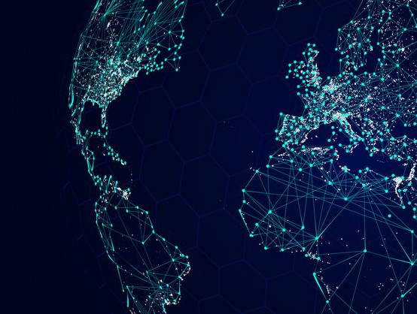
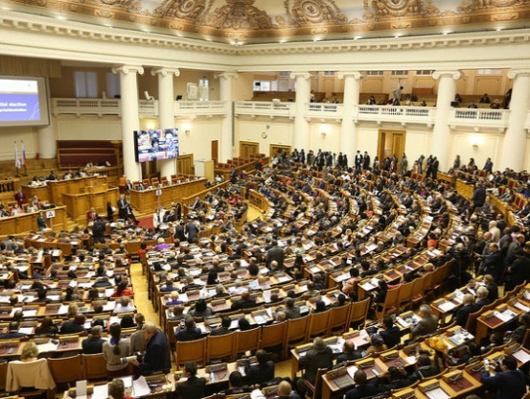
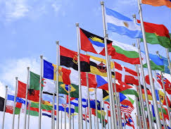

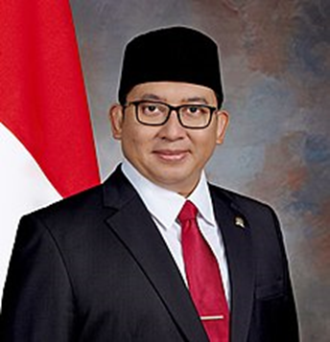
The Role of Parliamentarians in Addressing the Challenges of COVID-19 through Implementation of Existing International Biosecurity and Biosafety Frameworks
CHAIR OF THE COMMITTEE FOR INTER-PARLIAMENTARY COOPERATION INDONESIAN HOUSE OF REPRESENTATIVES
Dr. Fadli Zon,S.S.,M.Sc
Notes:
© Copyright Showeet.com – Free PowerPoint Templates

Slide 2



OUTLINE
COVID-19 SITUATION IN INDONESIA
INDONESIAN PERSPECTIVE ON THE USE OF BIOLOGICAL MATERIALS AS WMD
THE ROLE OF PARLIAMENTARIANS IN ADDRESSING BIOLOGICAL SECURITY CHALLENGES
Notes:
© Copyright Showeet.com – Free PowerPoint Templates

Slide 3

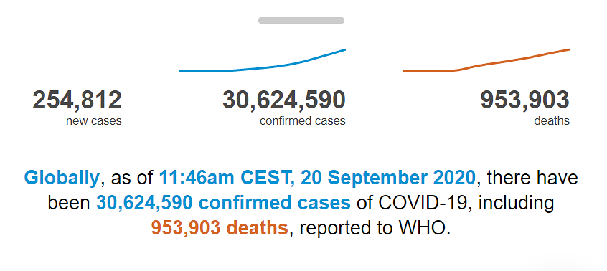
COVID – 19 SITUATION
GLOBAL
Source: WHO, 20/09/2020
Notes:
© Copyright Showeet.com – Free PowerPoint Templates

Slide 4
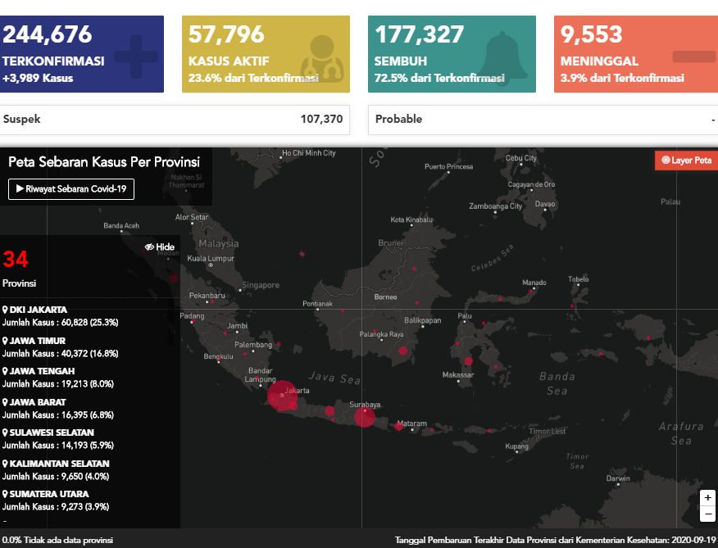
COVID – 19 SITUATION
INDONESIA
Massive testing
Aggressive tracing
Quick treatment
Active public participation
Source: Covid19.go.id, 20/09/2020
Notes:
© Copyright Showeet.com – Free PowerPoint Templates

Slide 5
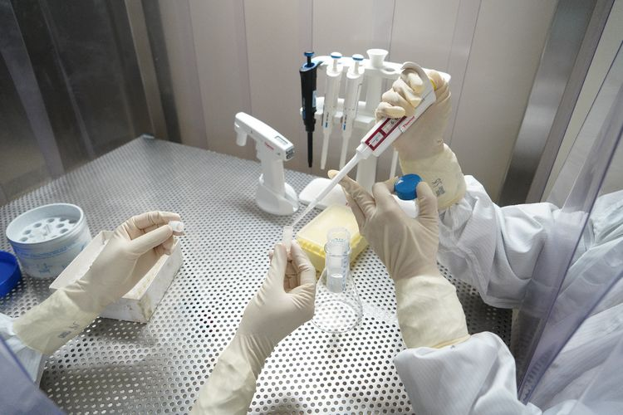
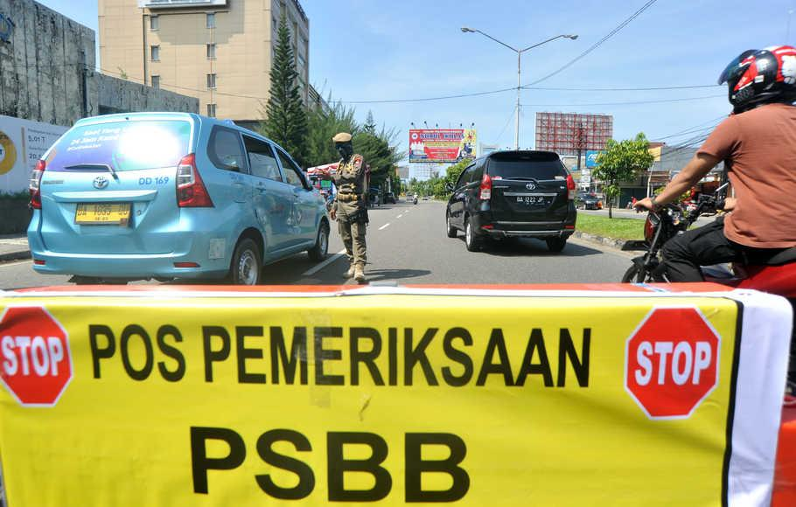
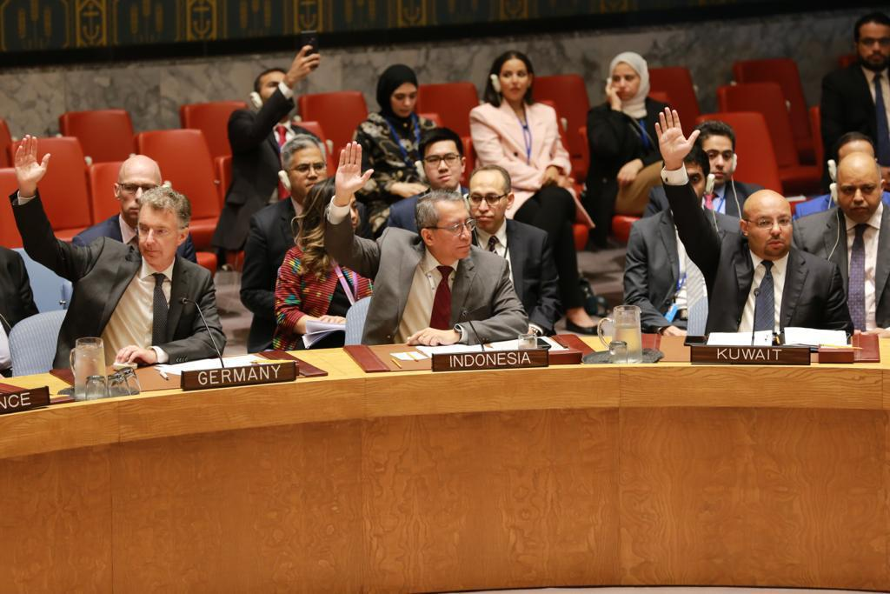
COVID – 19 SITUATION
INDONESIA
The initial testing capacity of 10, 000 specimens has now been improved to 26, 000 specimens
Not applying total lockdown at the national levels, but the large scale social restrictions (Indonesian Law number 6/2018 on Health Quarantine)
Developing and producing ventilators
Joining the global race in developing COVID-19 vaccines
“Spirit of mutual cooperation” by the enhanced cooperation and collaborations among parliamentarians
Notes:
© Copyright Showeet.com – Free PowerPoint Templates

Slide 6
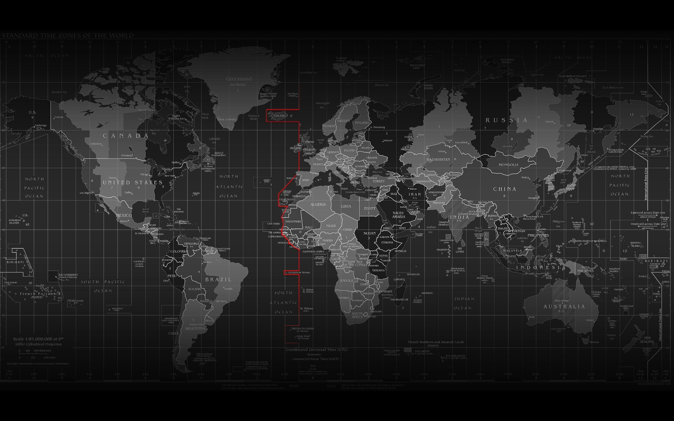



NATIONAL MITIGATION EFFORTS
Indonesian House enacted on Law number 2/2020 on State Financial Policy and Stability of Financial Systems for the Management of COVID-19
TOTAL STIMULUS OF 669,7 TRILLION

PARLIAMENT’S ROLE
The role of parliaments is more crucial than ever because as the pillar of democracy, they must perform effectively despite the pandemic
Health
Social Safety Net
Business Incentives
Small, Micro and Medium Enterprise
Corporate Financing
Sectoral Needs & Regional Government

Slide 7
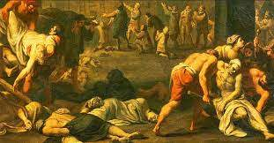
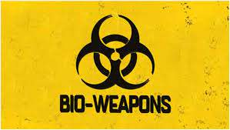

INDONESIAN PERSPECTIVES ON BIOLOGICAL MATERIALS AS WEAPON OF MASS DESTRUCTIONS
History has witnessed that biological warfare was used by both state and non state actors, example: 1346, the Mongols were struck by the plague in Caffa (northern coast of the Black Sea)
“Black Death” was responsible for 75 – 200 million deaths in Eurasia at that time
Biological weapons have transformed, no country can face the problem unilaterally
Notes:
© Copyright Showeet.com – Free PowerPoint Templates

Slide 8
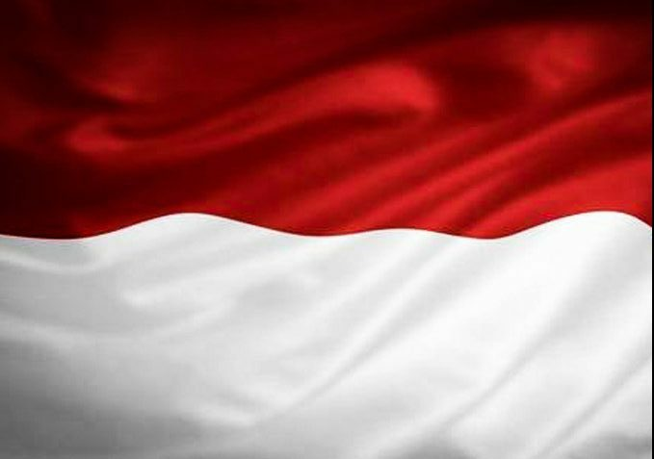

INDONESIAN PERSPECTIVES ON BIOLOGICAL MATERIALS AS WEAPON OF MASS DESTRUCTIONS
Indonesia has ratified the Biological Weapon Convention (BWC) in 1992
Indonesia attaches great importance to the three pillars (disarmament, non-proliferation, and international cooperation for peaceful use) of the Convention which must be balanced
Indonesia supports all forms of international cooperation in the field of peaceful use of biological agents, including capacity building and combating infectious diseases
Indonesia views that BWC has not been equipped with a verification system for monitoring compliance of State Parties
World is full of unpredictability, security threats have evolved.
This Convention should not just be politically binding, but legally binding
Notes:
© Copyright Showeet.com – Free PowerPoint Templates

Slide 9
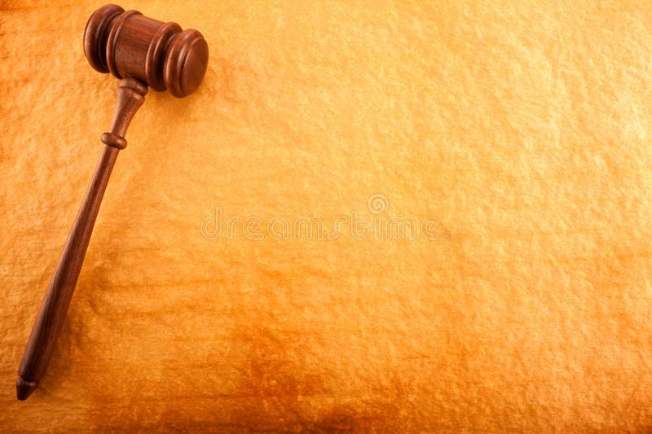
INDONESIAN PERSPECTIVES ON BIOLOGICAL MATERIALS AS WEAPON OF MASS DESTRUCTIONS
Indonesian Parliament is now deliberating on the revision of Law number 4/1984 on Infectious Diseases (part of National Legislative Program 2020-2024)
Indonesia allocates 5% of the State Budget for health care sectors
COVID-19 is the momentum for every country in the world, to recalibrate our national health systems, to be more resilient in responding any potential challenges
Indonesia is also in the deliberation of Bill on National Security (part of them will emphasize on the approach toward holistic national security: public security, individual security – and health security, and state security
Notes:
© Copyright Showeet.com – Free PowerPoint Templates

Slide 10


THE USE OF BIOLOGICAL AGENTS FOR
PEACEFUL PURPOSES
Promoting advances in life sciences that benefit all humanity should go with safeguarding against their use for malicious purposes
It is important to consider international cooperation and assistance related to the use of biological agents for peaceful purposes without any discriminations
Indonesia welcomes collaborations and cooperation including trainings and advocacy on biosafety and biosecurity, as well as capacity building and combating infectious disease
Notes:
© Copyright Showeet.com – Free PowerPoint Templates

Slide 11
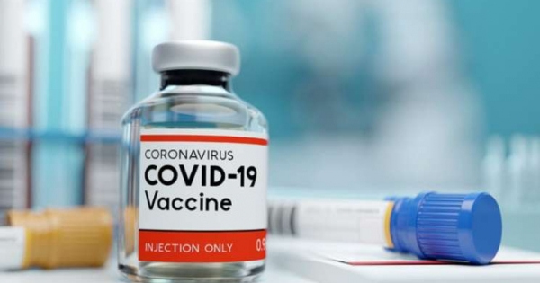

THE USE OF BIOLOGICAL AGENTS FOR
PEACEFUL PURPOSES
COVID-19 has energized our drive for self-reliance in pharmaceuticals
Indonesia develops our own vaccines named “Vaksin Merah Putih” or Red and White Vaccines.
Developed by Indonesia’s state owned enterprise Bio Farma, Jakarta-based Eijkman Institute for Molecular Biology and other research agencies and universities in Indonesia
As a generic vaccine maker, Bio Farma has been exporting to more than 140 countries and is looking to become a leading Asian biotechnology company. We hope this vaccine to be ready in the middle of 2021.
Notes:
© Copyright Showeet.com – Free PowerPoint Templates

Slide 12
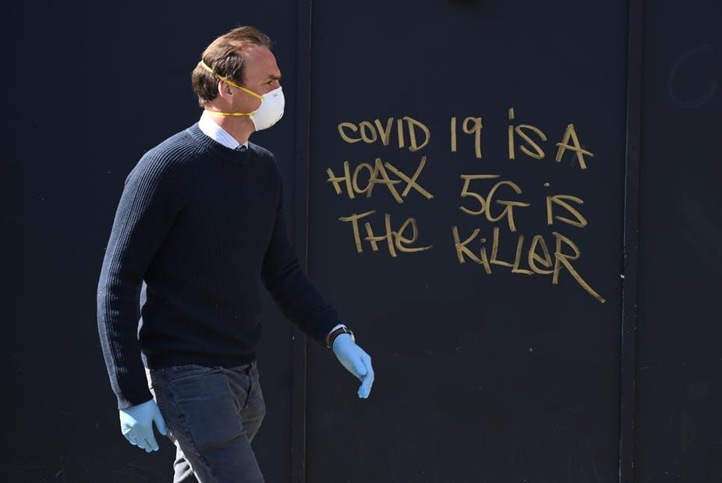
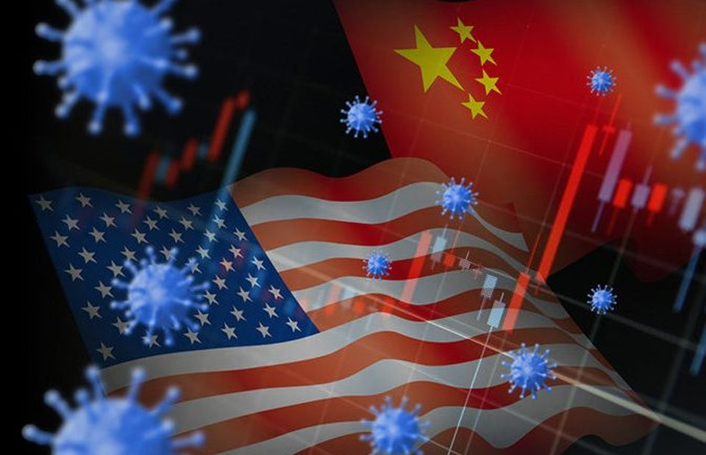

THE ROLE OF PARLIAMENTARIANS IN ADDRESSING BIOLOGICAL SECURITY CHALLENGES IN RELATION TO COVID-19
COVID-19 -is fueling mistrust among countries. Questions of the virtue of globalization and interconnectedness arise
Global political rivalry amplifies as some countries are playing the blaming game on the origins of COVID-19
While unfortunately, at the same time more people are suffering due to the pandemic
This situations is certainly not conducive at a time where global solidarity and collaborations are imperative
Notes:
© Copyright Showeet.com – Free PowerPoint Templates

Slide 13

1. Building a resilient society
Through the enactment of national legislations, budget allocations, and overseeing executive’s actions which respond to a wide range of challenges
2. Enhancing coordination and cooperation
No country is immune from the virus; unity, solidarity, and international cooperation are necessary
Avoid any tendency for power competition as it can hinder our collective efforts to build a more resilient world
Amplifying parliamentary diplomacy
Notes:
© Copyright Showeet.com – Free PowerPoint Templates

Slide 14
Our priority must be to safeguard the health and well-being of everyone, to minimize the number of infections and ensure all get proper treatment
We must also remain vigilant against the threat of biological weapons as COVID-19 has exposed our vulnerabilities
CONCLUSION
Through shared responsibility and enhanced global solidarity, we can recover better
Let’s build a more resilient world, not only to beat the virus, but also to tackle its profound consequences, as well as to address other potential security threats
Notes:
© Copyright Showeet.com – Free PowerPoint Templates

